Slide 1

An undertaking of Bhaktapur Municipality KHWOPA COLLEGE OF ENGINEERING (Affiliated to Tribhuvan University) Libali - 8, Bhaktapur
Prepared By
Binita Shah
Indira Parajuli
Sanjit Kumar Thakur

Slide 2
Introduction
type of training that occurs in the workplace, rather than in a classroom or other learning environment
involves a trainee being given the opportunity to learn new skills and knowledge by working alongside more experienced colleagues
to show trainee the reality about working
exposed to the actual work related to the course that they are taking

Slide 3
Importance
to learn in a real-work environment, which can help them better understand the practical applications of their new skills
to learn at their own pace, which can make the learning process more effective and efficient.
improve student retention

Slide 4
Objectives
to help trainee develop the skills and knowledge they need to be successful in their job, while also benefiting the organization through increased productivity
helps to tackle different situations that may arise in the organization and be able to know how to socialize well with colleagues and develop good teamwork

Slide 5
Skills Developed
Report Writing (Word)
Manipulation of Data (Excel)
format, organize and calculate data in a spreadsheet.
Presentation (PowerPoint)
Communicate with the audience through graphics, text or videos.
Networking (Cisco)
Database Design
Git
Coding (PHP, HTML, CSS, Cisco)
Mathematics Session

Slide 6
Microsoft Word
Basics of word (Fonts, Page Layout, Margin, Alignment, Bullets & Numbering)
Formatting, structures, referencing etc.
Mail Merge (e.g., ID Card)
Usage
Preparation of Report i.e., monthly reports.
ID Card creation using mail merge.

Slide 7
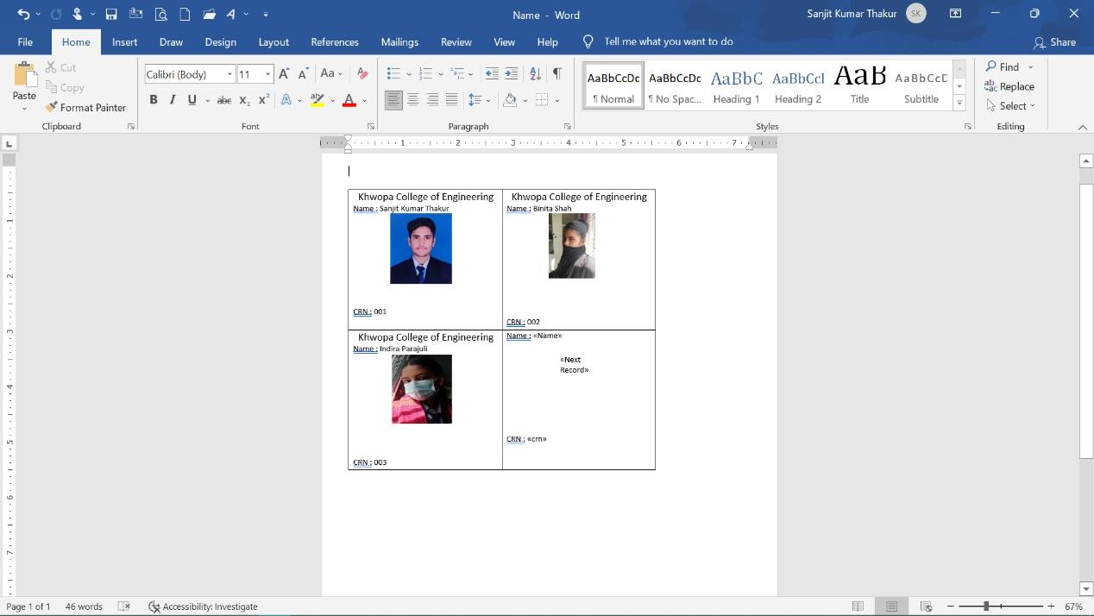
Mail Merge

Slide 8
Microsoft Excels
Basic of excel
Conditional formatting (E.g. If, VLOOKUP, Concatenate, Upper, Lower, Proper etc.)
Filters, charts
Usage
Data entry (letter registration, letter forwarded, scholarship, final report and so on)
Mail merge
Student details collect and sort on the basis of districts

Slide 9
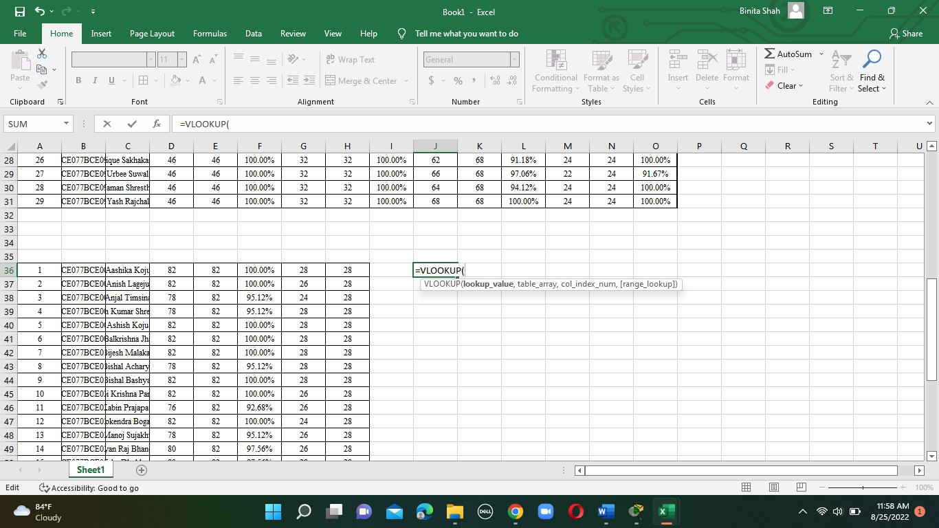
Using VLOOKUP to organize the data

Slide 10
Microsoft PowerPoint
Basics of PowerPoint
Transitions and Animations, use of design templates and so on.
Usage
Preparing presentation and conveying information on the basis of UI, graphs and so on.

Slide 11
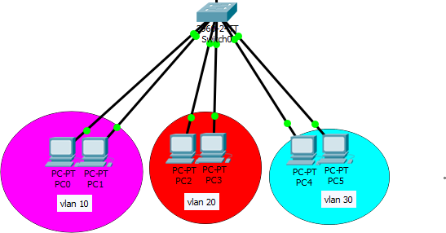
Cisco Design
IP DHCP
is a network protocol used to dynamically assign IP addresses to devices on a network.
Vlan
is a logical network that can be created on top of a physical network)
Inter Vlan Routing
process of routing traffic between different VLANs (Virtual Local Area Networks).
Creating vlan

Slide 12
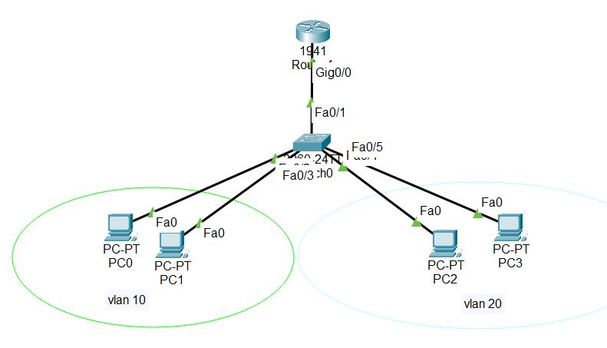
Cisco Design Continue..
Telnet
is a network protocol that allows a user to connect to a remote computer and access its command-line interface).
Example : Remote Desktop Connection
DNS
is a server that translates human-readable domain names into numerical IP addresses that computers can understand).
Inter Vlan

Slide 13
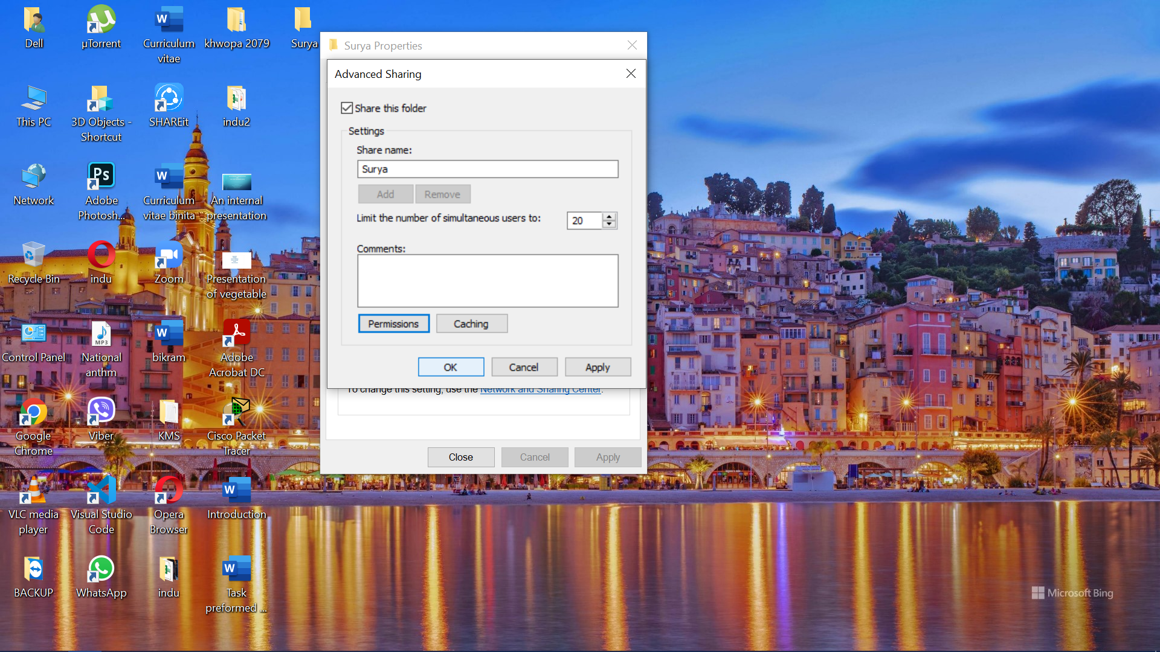
Cisco Design Continue..
Usage
File share in network
CN-pilot router installation

Slide 14
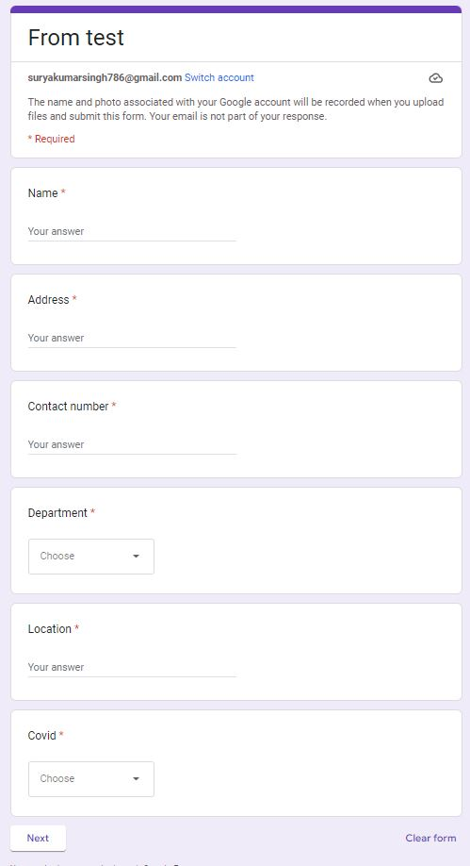
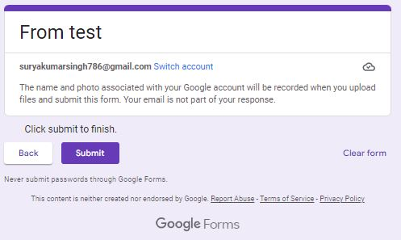
Google Forms
Basics of google form, different question types, data collections
Created google forms and shared the link with the friends.
Google forms created for test

Slide 15
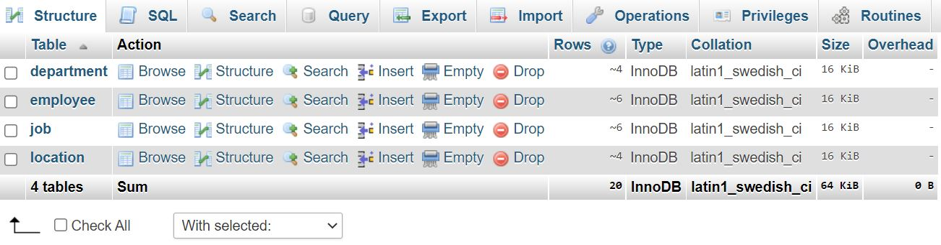
Database Design and Different Operations
Database Creation
Table Creation and Relations Between different tables
CRUD Operation
SQL Query
Join
Sub Query
Aggregate Functions
CREATE TABLE orders (
id int PRIMARY KEY AUTO_INCREMENT,
user_id int,
FOREIGN

Slide 16
Database Continue..
CRUD Operation (CRUD stands for Create, Read, Update, and Delete).
SQL Query
SELECT: Used to retrieve data from the database.(SELECT * FROM users WHERE age > 25;)
INSERT: Used to insert new data into the database.
UPDATE: Used to modify existing data in the database.
DELETE: Used to delete data from the database.
CREATE: Used to create new tables or other objects in the database.

Slide 17
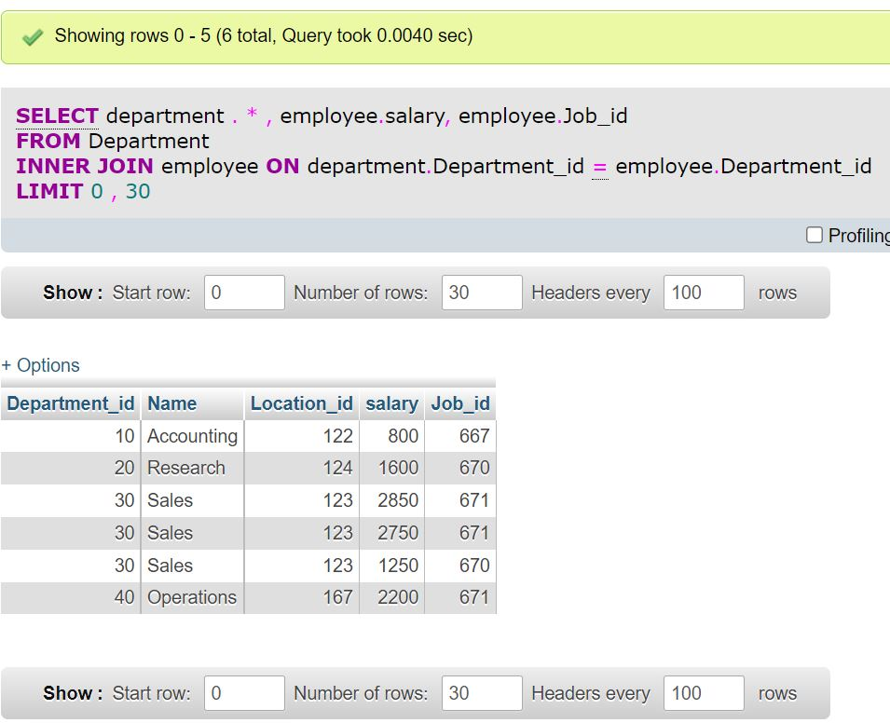
Select query with join

Slide 18
PHP
PHP Syntax, Variables, Echo and Print
Data types (String, Integer, Character, Constant and so on)
Operator, Conditional Statement
Loop, Function, Array & its types, Supper Global Variable, Datetime.
Session & Cookie, Exception Handling
Database and MySQL
Database module generate SQL

Slide 19
Database and MySQL - is software that is used to create and manage databases.
Database Module
Install the necessary software and libraries
Configure the database module
Test the connection

Slide 20
Database Module generate SQL
PHP database module have the ability to generate SQL (Structured Query Language) statements based on user input or other criteria.
SQL is the standard language for interacting with relational databases, and is used to perform various operations such as querying data, inserting, updating, and deleting records, and creating and modifying database objects such as tables and views.

Slide 21
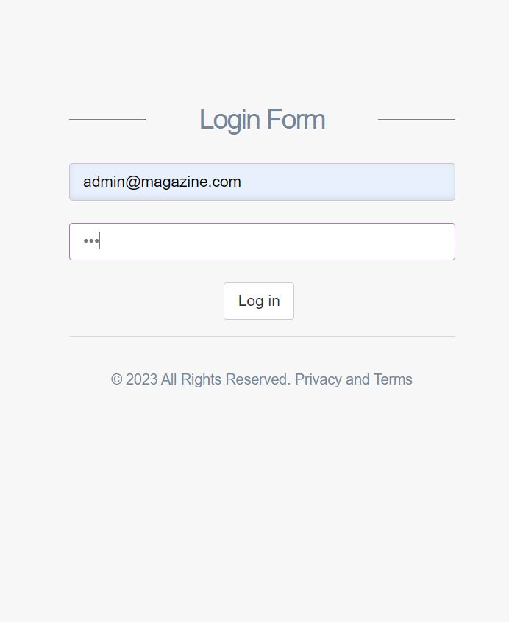
Login Page

Slide 22
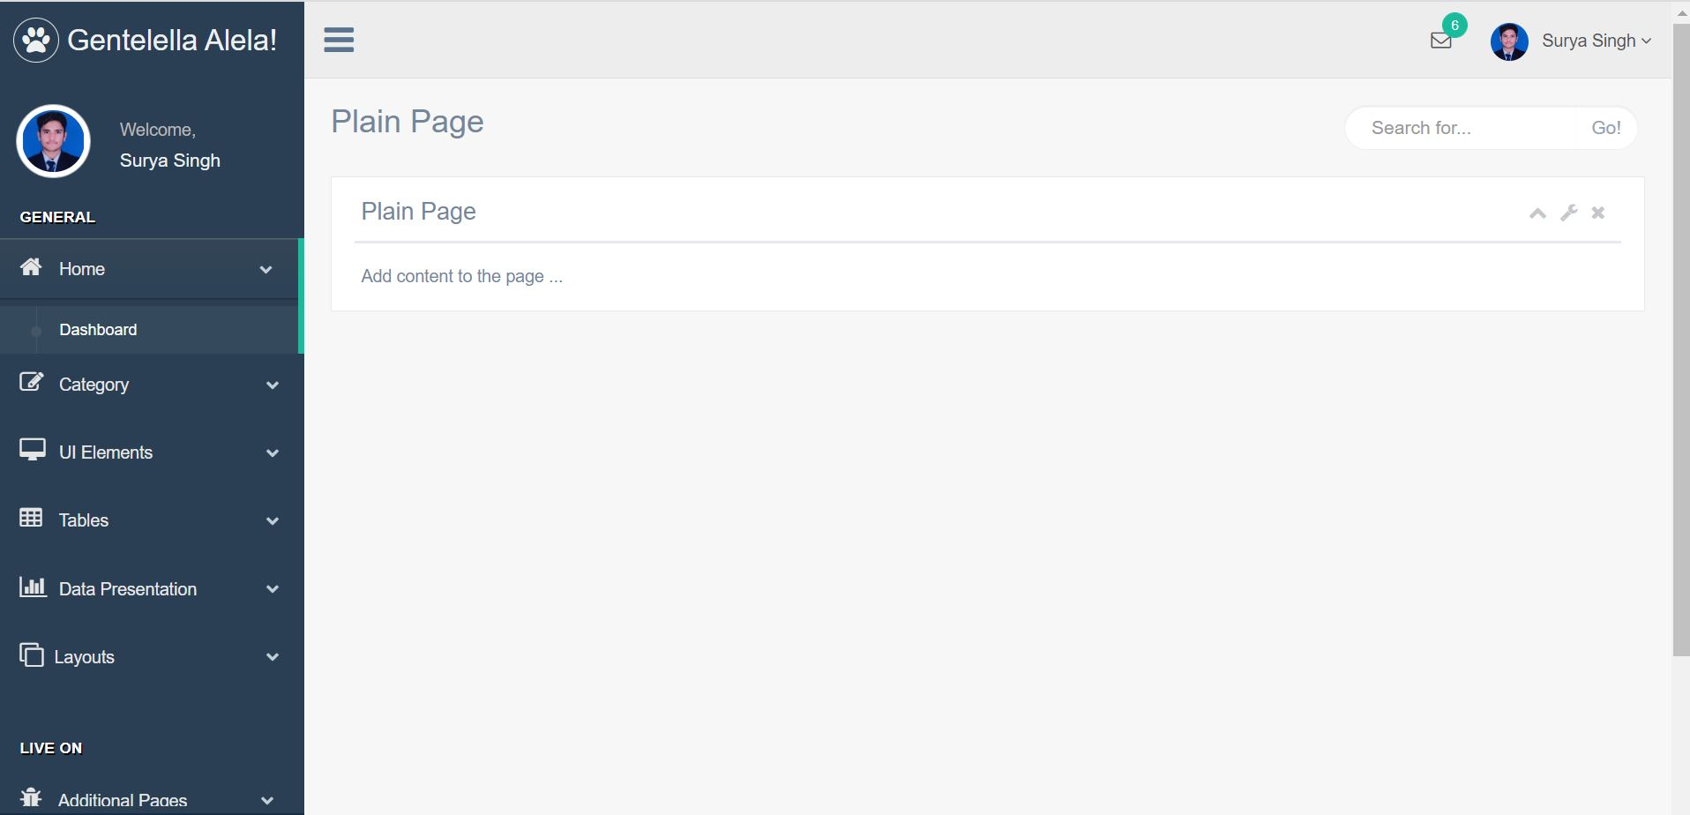
Dashboard After Cleaning

Slide 23
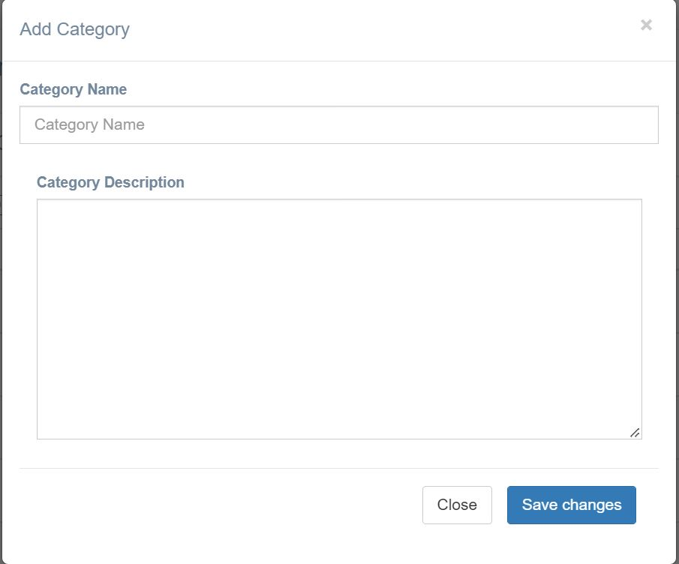
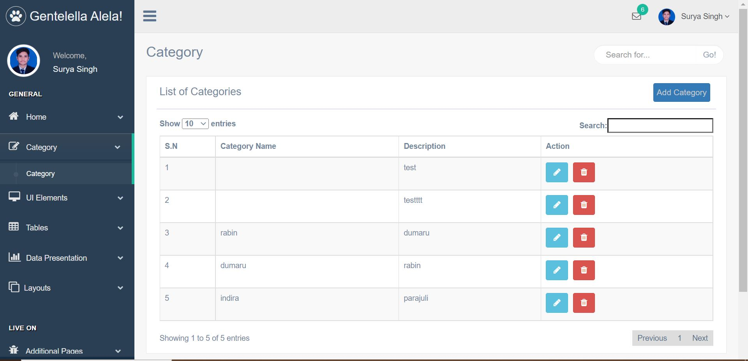
Database add data
Add Category tab

Slide 24
Git
Git bash - to execute Git commands and perform various tasks such as cloning repositories, creating branches, committing changes, and pushing code to remote servers
Project file configuration
Pull & Push - pull and push are two important commands that are used to manage the relationship between a local repository and a remote repository.)
Publish static website
Usage
Publish static website in git account
Store file in GitHub

Slide 25
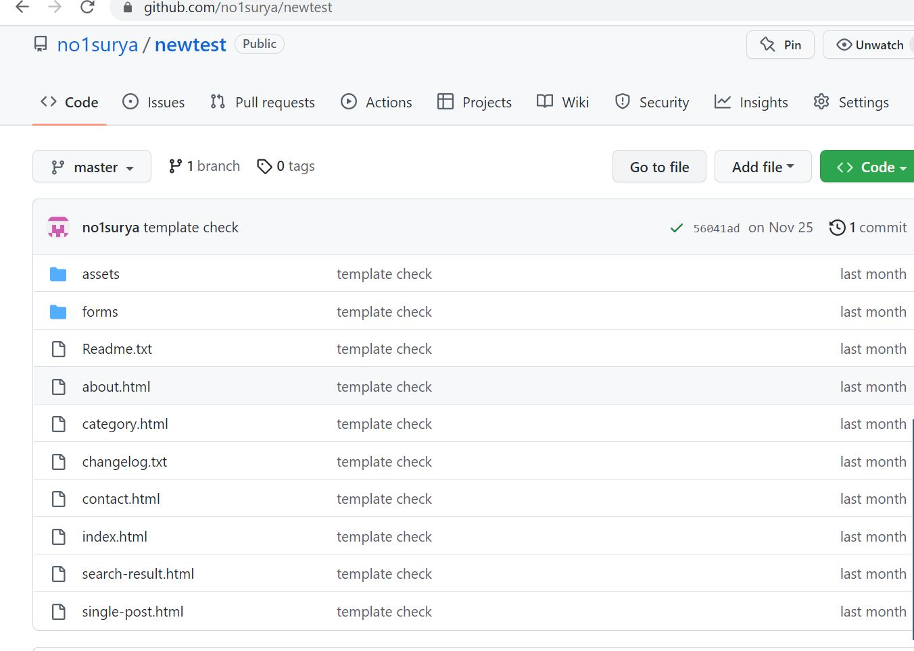
Upload local file in GitHub

Slide 26
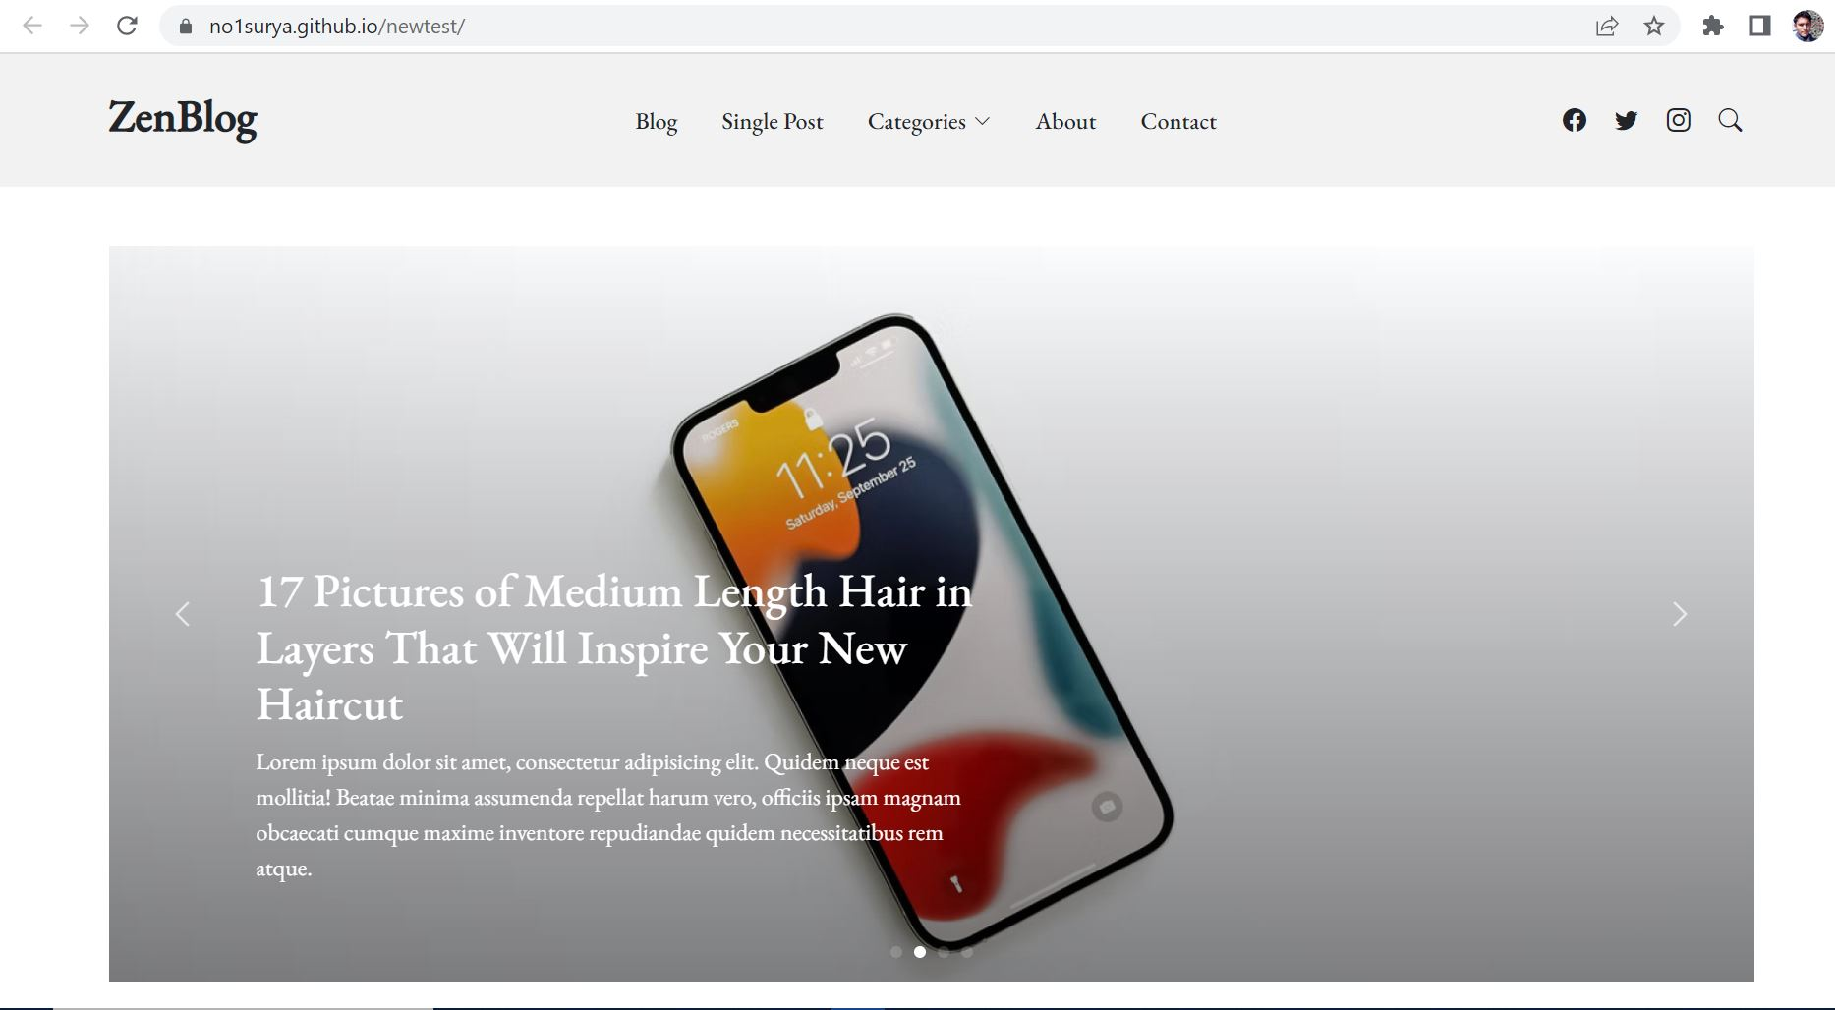
Publish local repo in GitHub

Slide 27
Mathematics Practice for class 12 Back exam
Permutation and Combination
Statistics
Probability
Linear Programming
System of Linear Equations
Numerical Integration

Slide 28
Different Tasks Performed
Document Scanning (Letter Forwarded, Internal Letter Forwarded, Letter Registration, Old Question, Batch 2077 and 2078 all documents)
Data collection and manipulation in Excel (Scholarship data, Final Result Preparation)
QA Testing of KhEC EMIS app (Take attendance of all student, Check assignment)
Windows Activation & Installations in Lab (Block C, F & G)
Assist in IOE Priority Forms
Setup Router for IP camera
Create Teams in MS-Teams for new Session.

Slide 29
Different Tasks Performed Continue…
RJ45 cable connection
Repair computers in labs (Formatting, Windows Installation, Software Installation, Dual Booting, SSD addition, and so on).
Printer Sharing in Network

Slide 30
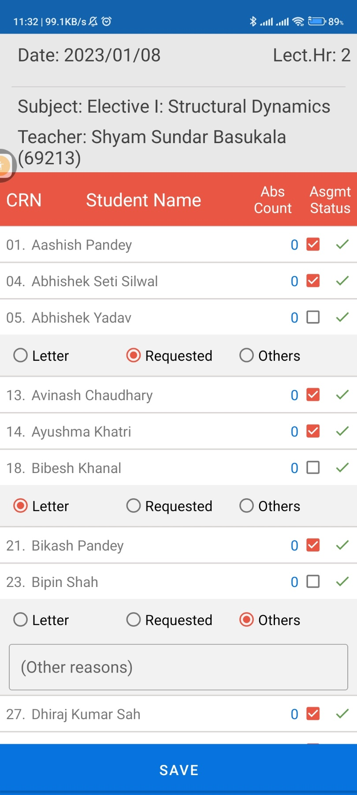
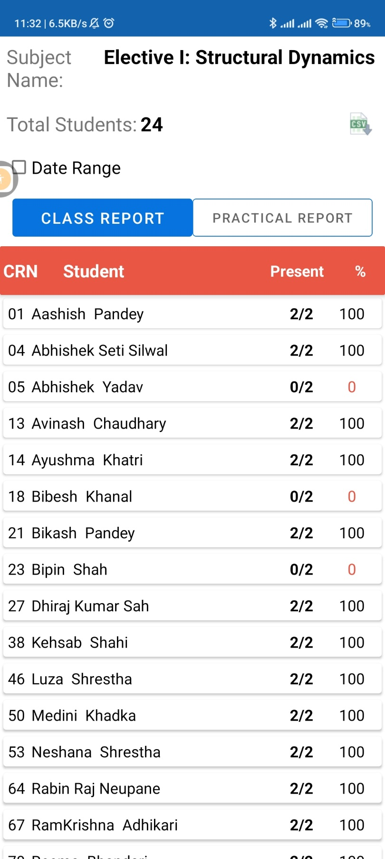
Take attendance of all student
Assignment check

Slide 31
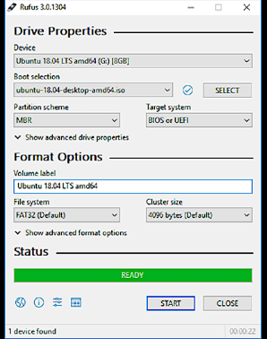
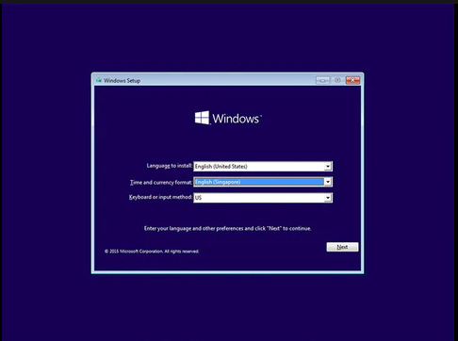
Bootable USB creation
Windows Installation

Slide 32
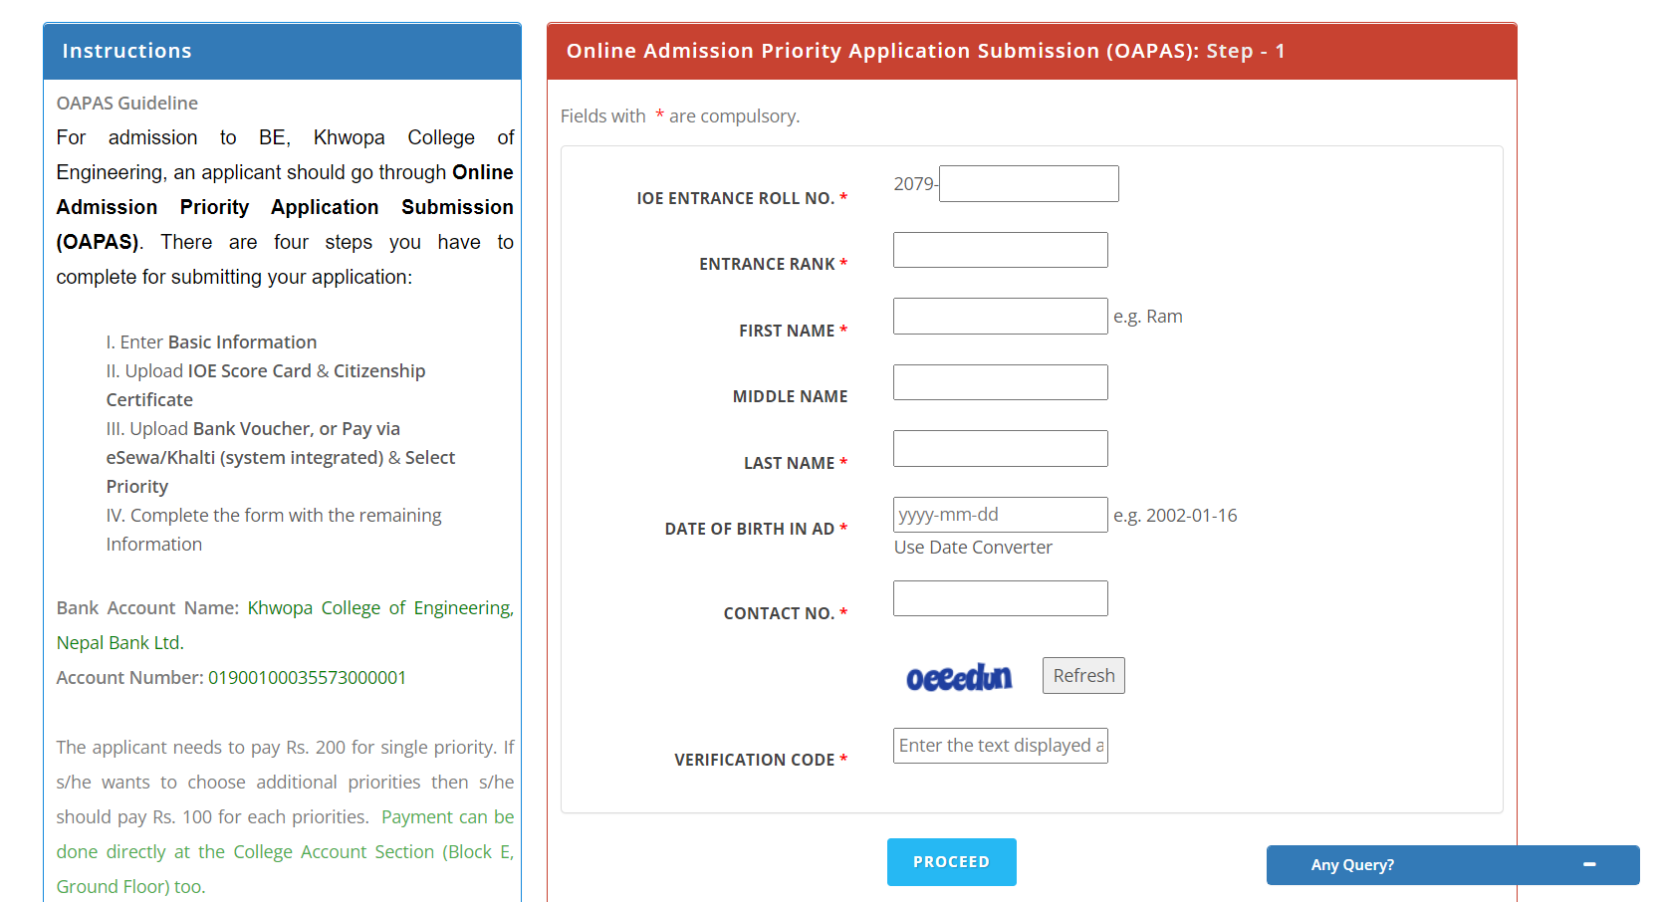
Assist in Priority form

Slide 33
Thank You !

